Slide 1
Date: 01/11/2025
ITW Workshop Part-II (Teaching Demo)
CMOS Inverter
Ramesh Sambangi
EEE Department

Slide 2
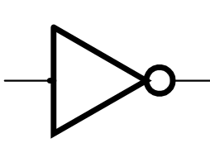
Inverter
Truth Table
A | Y
0 | 1
1 | 0
A
Y = A
An inverter is an electronic circuit that flips whatever signal it receives.

Slide 3
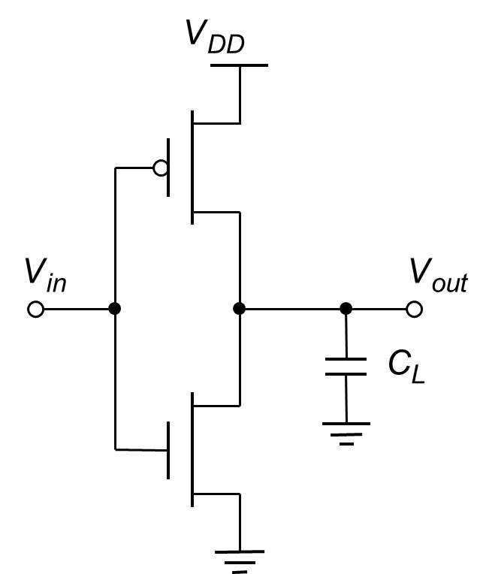
CMOS inverter
A CMOS inverter is the simplest and most important logic gate built using CMOS technology.
Feature | Explanation
Very low power | Almost no current flows except during switching
High noise immunity | Stable and reliable operation
High speed | Fast switching due to complementary action
Compact design | Needs only two transistors per inverter
Truth Table
A | Y
0 | 1
1 | 0

Slide 4
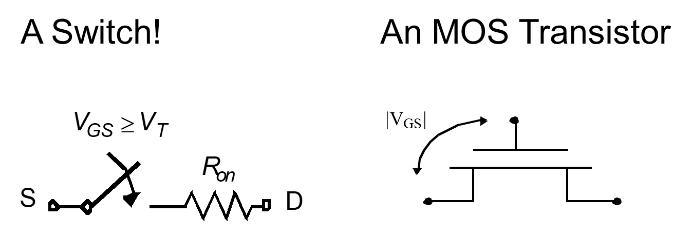
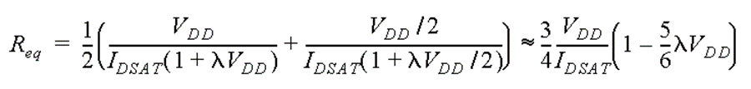

Slide 5
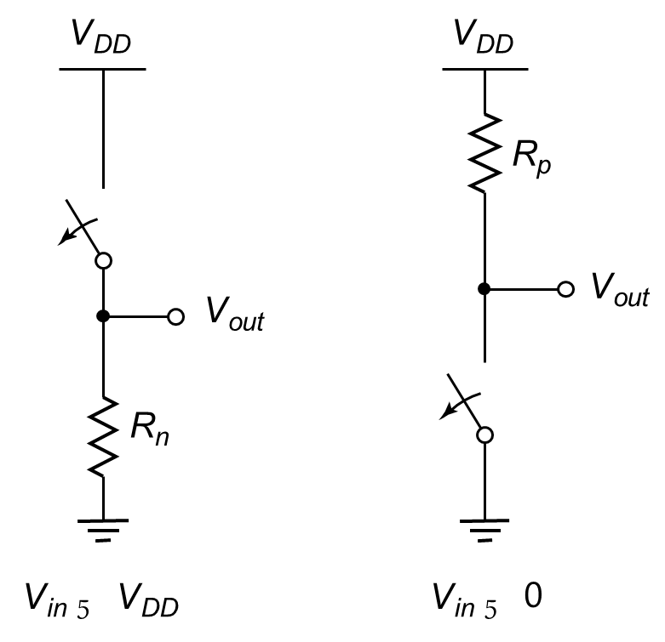
CMOS Inverter
First-Order DC Analysis
=
=

Slide 6
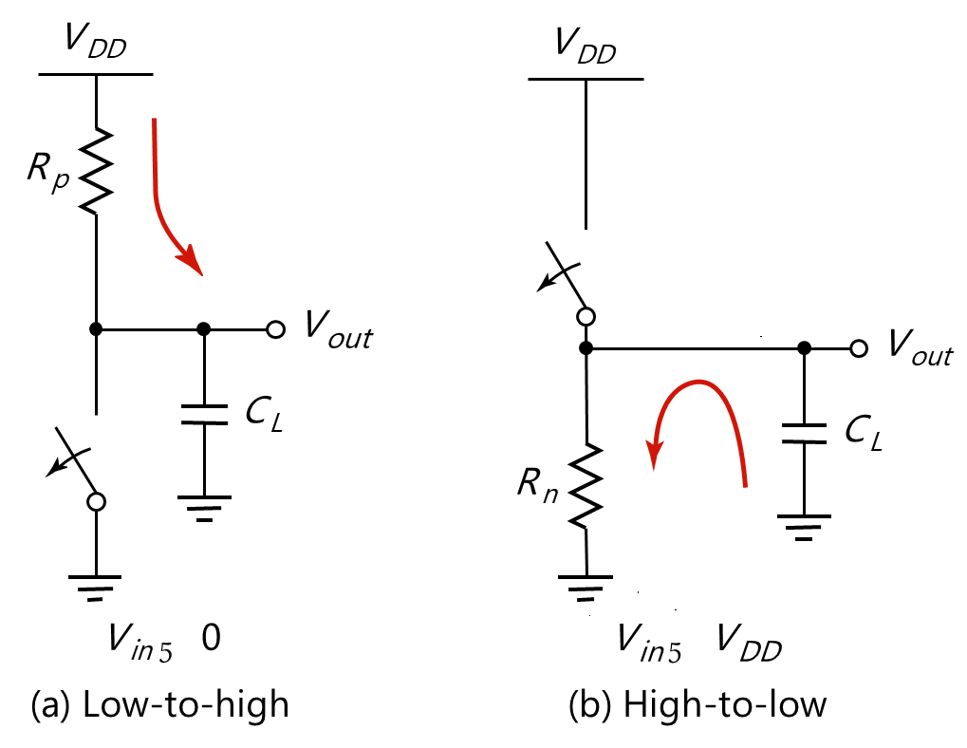
CMOS Inverter: Transient Response
t_{pLH} = 0.69 C_{L}R_{eqp}
t_{pHL} = 0.69 C_{L}R_{eqn}

Slide 7
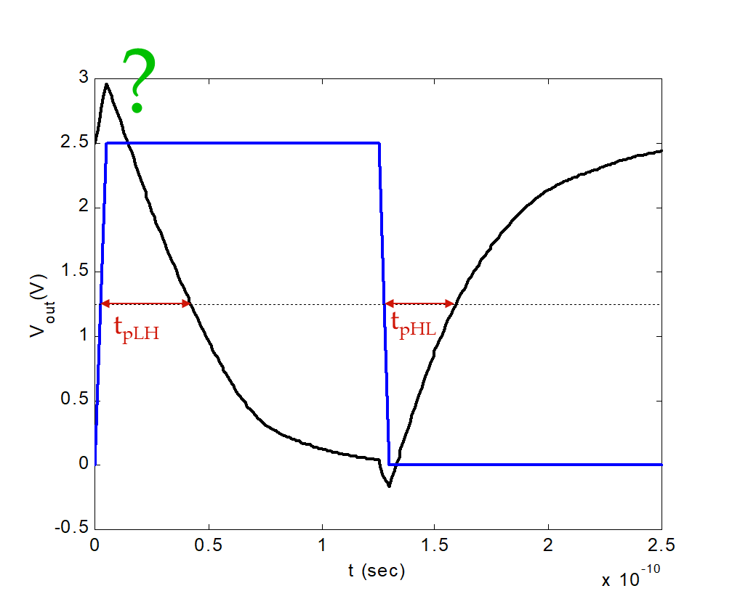
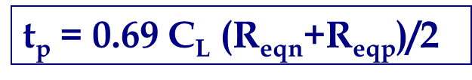
Contd.

Slide 8
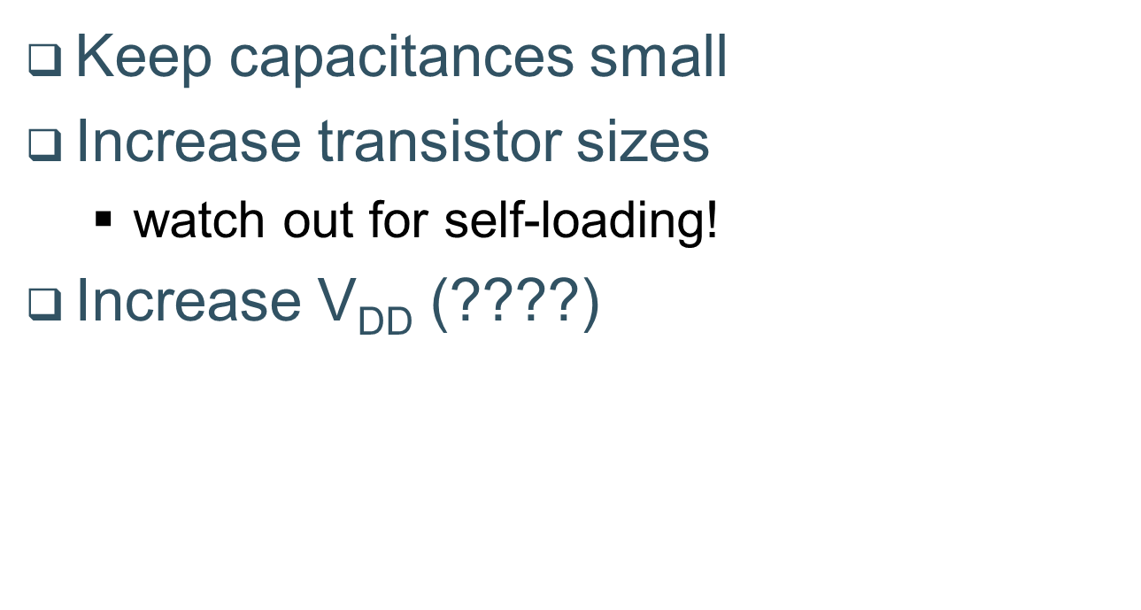
Design for Performance

Slide 9
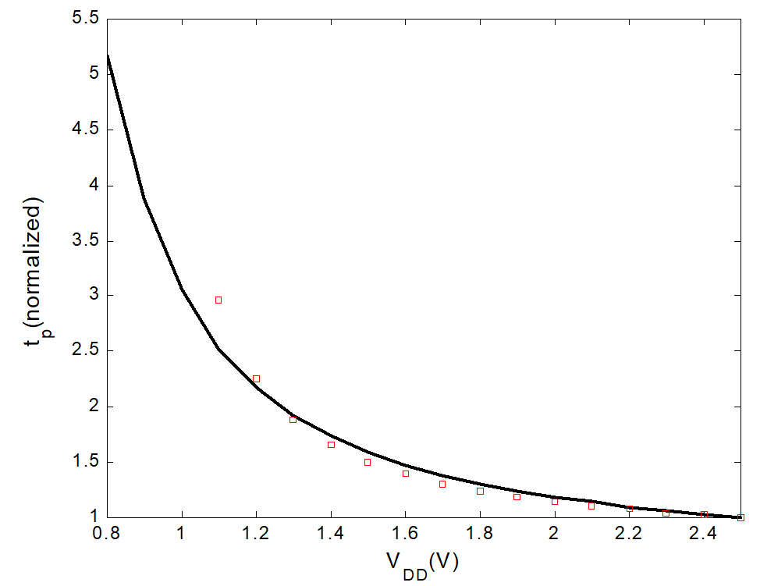
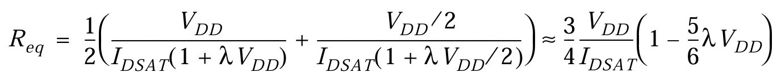
Delay as a function of V_{DD}

Slide 10
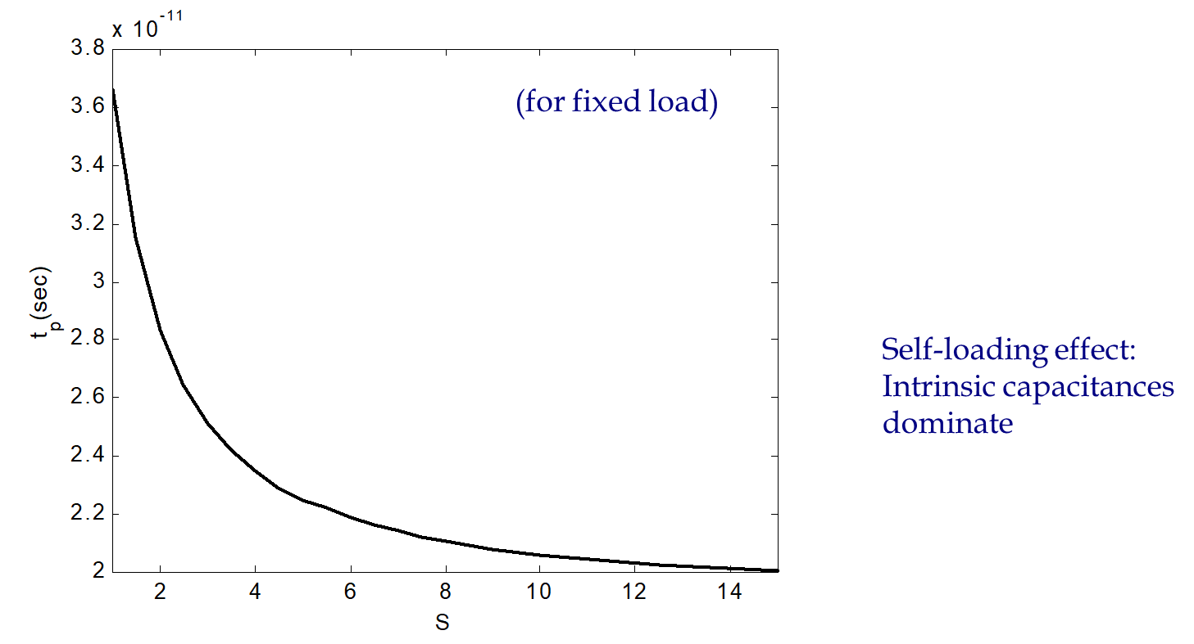
Device Sizing

Slide 11
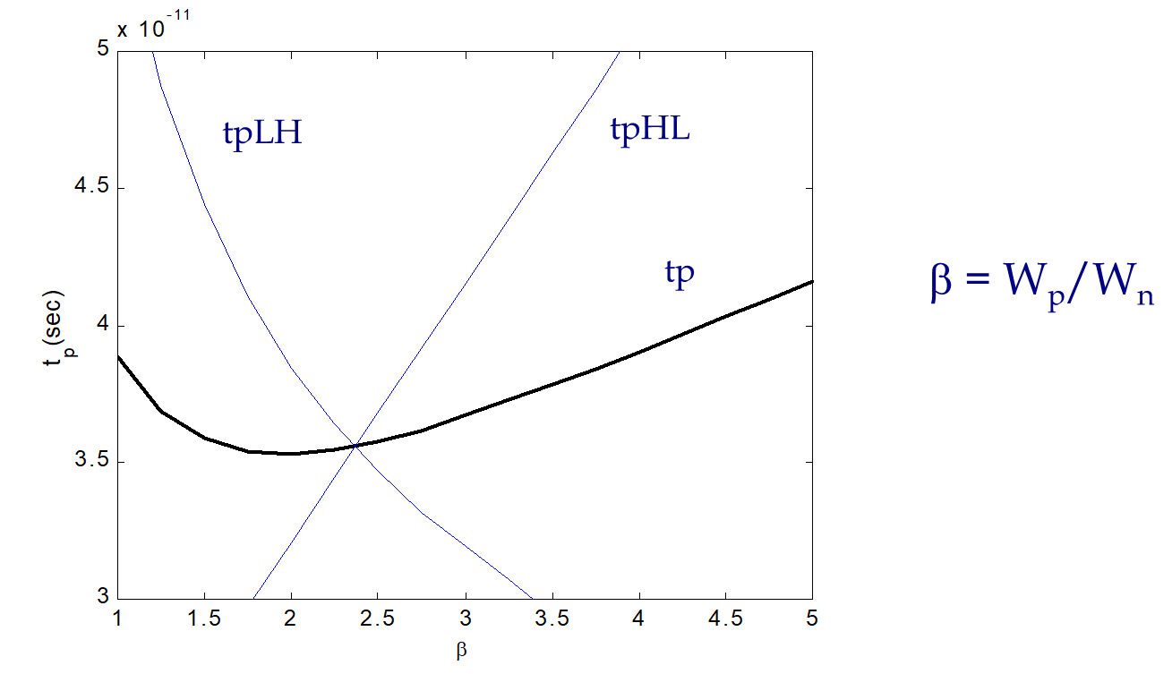
NMOS/PMOS ratio

Slide 12
Power Dissipation
• Dynamic Power Consumption
Charging and Discharging Capacitors
• Short Circuit Currents
Short Circuit Path between Supply Rails during Switching
• Leakage
Leaking diodes and transistors

Slide 13
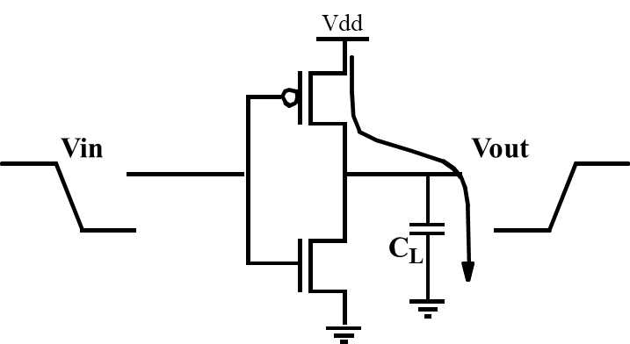
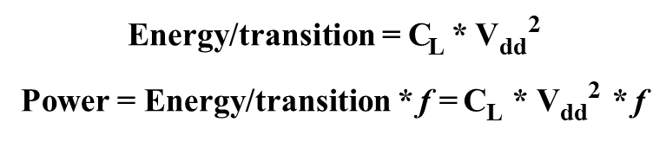
Dynamic Power Dissipation

Slide 14
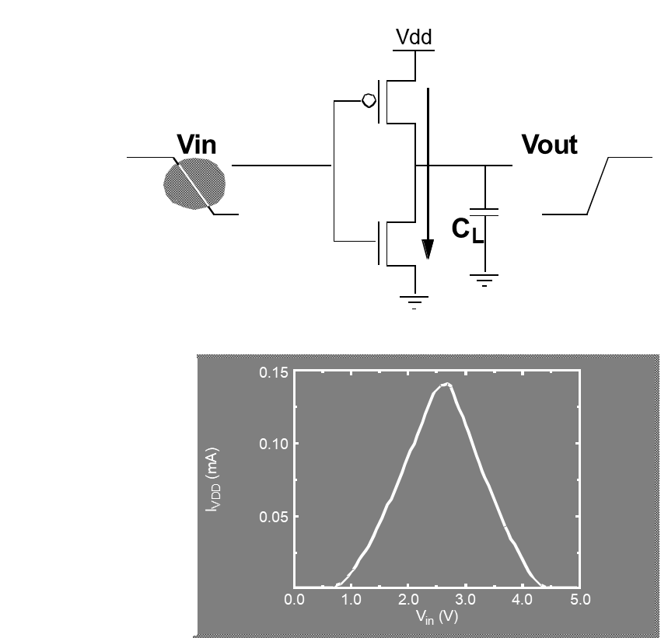
Short Circuit Currents

Slide 15
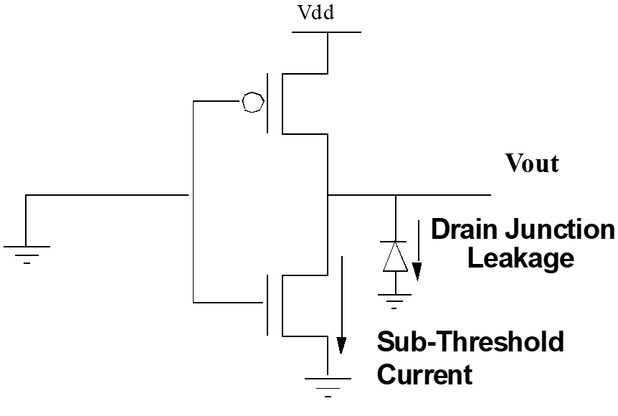
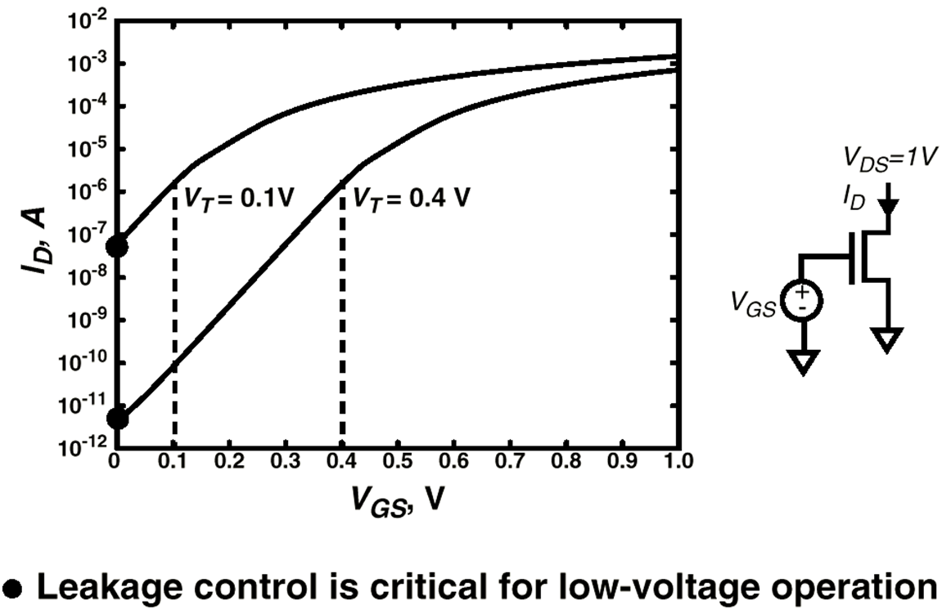
Leakage

Slide 16
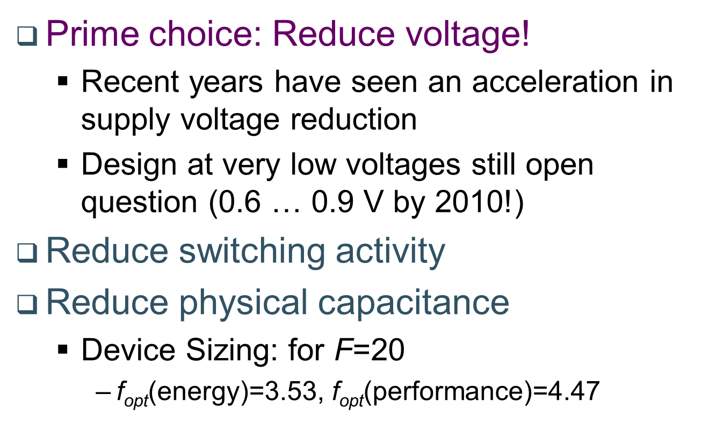
Principles for Power Reduction

Slide 17
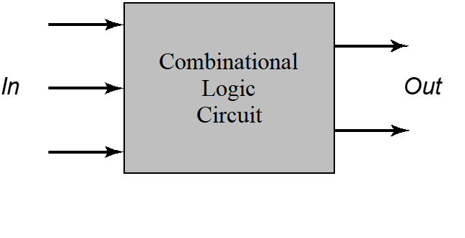

Combinational Logic Design

Slide 18
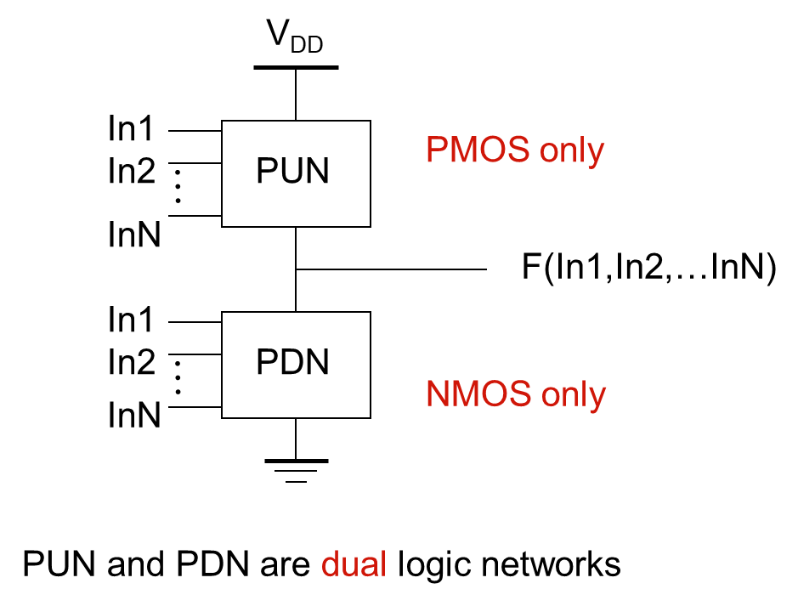
Static Complementary CMOS

Slide 19
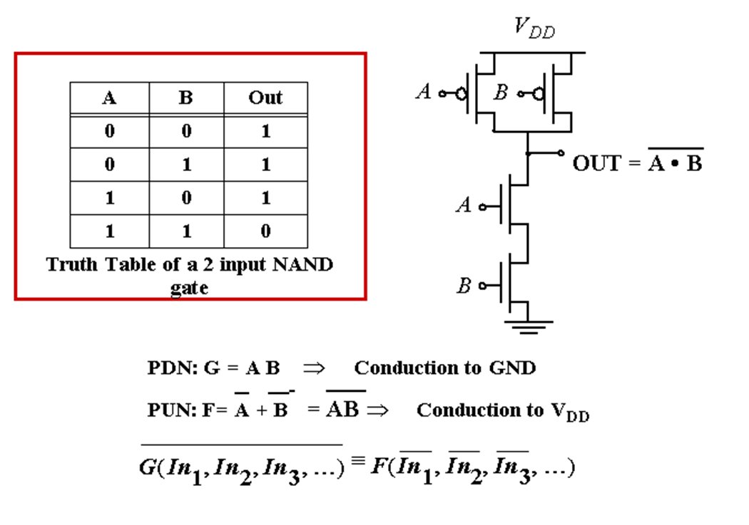
Example Gate: NAND

Slide 20
Thank You

